Slide 1
Dean’s List Judging Process
MRA Mentor Education Day - June 2, 2018
How the Mentors Can REALLY Make a Difference!

Slide 2
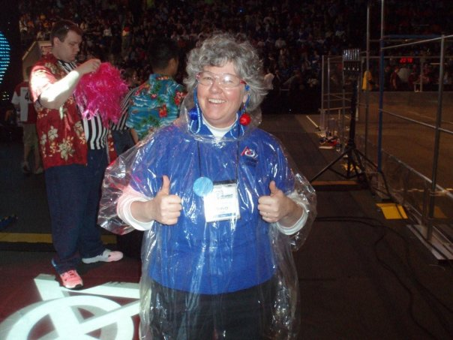
Jenny Beatty
DL Judge for FIRST Chesapeake the past 2 years.
Notes:
Judge for numerous FIRST competitions since 2005. Dean’s List Manager for FTC in MD for 3 years and Dean’s List Award Judge for FRC the past 2 years at District Qualifiers. I have been a judge in FRC since 2005. My day job is working in volunteer engagement.

Slide 3
How many here have nominated a student?
Why should you nominate a deserving student?
The bigger picture.
But you need to factor in the time to do a decent job.
Notes:
This is an awesome award!
Doing their 5-min. elevator pitch is the same skills the students need for internships, jobs and college. Having this interview is a valuable experience.
Nomination can go in their school file for internships, jobs and college. And can help with scholarships.
Last season only 30% of teams in FIRST CHS submitted a nomination.

Slide 4
Who is eligible?
Sophomores and Juniors in high school
Can be nominated for both FTC & FRC. (But may be better to pick the program they are most competitive for)
Notes:
Sophomores and Juniors in high school.
Students that would be attending college or university in the next academic year are not eligible.
A student involved in both FIRST Robotics Competition and FIRST Tech Challenge is eligible to be nominated for both programs for the Dean’s List Award in their State’s/region program. However, the Coach or Mentor writing the nomination should focus the essay on the student’s accomplishments in the program in which they are being nominated. If the student is being nominated in each, the Coach/Mentor should adjust the content of each essay to each program.

Slide 5
The Dean’s List Award process
There are so many deserving students. The judges need to pick the students who are going to be most competitive at World Championship level from the entire FIRST Chesapeake District. This is HARD work.
Help us!
Notes:
Team picks 1 or 2 candidates
Mentor writes submission and enters into the online portal. The student then becomes a “Dean’s List Semi-Finalist”.
DL Semi-Finalist is assigned a location for an interview. Not all FIRST Chesapeake District events will offer a DLI. The Dean’s List Manager will work with the Semi-Finalist to figure out a back-up plan if they cannot attend one of the events - usually a Skype interview. Mentors who nominated student(s) for the Dean's List Award will be contacted by their districts Dean’s List Manager to inform them at which event the student(s) will be interviewed. If two students are nominated on a team, both will be interviewed at the same event.
In 2018 - the DLI time was assigned before event. The time can be rearranged on-site if conflict.
7-minute interview.
In 2018 - a small percentage from each District qualifiers advanced to District CMP for a re-interview. The qualifier DL judges wrote an advancing nomination based on their interview which was paired with the mentor submission going into District CMP. At the District Championship the mentor submission and DL judge write-up of CMP interview were used to advance 4 students as “DL Finalists” to World Championship in Detroit.
There is no interview in Detroit. The 10 “DL Winners” at World CMP were chosen based on Mentor submission and write-up from Regional or District CMP judges.

Slide 6
The essay - Important!
Criteria
Demonstrated leadership and commitment to the ideals of FIRST
Overall contribution to their team
Ability to motivate and lead fellow team members
Effectiveness at increasing awareness of FIRST in the school and community
Technical expertise and passion
Entrepreneurship and creativity
Notes:
It Is not necessary to include the student’s activities outside of FIRST; focus on FIRST related activities
How are they a leader?
How do they motivate and lead fellow team members?
What are the student’s contributions to the Team, whether it is building, programming, leadership, etc.?
How have they helped increase the awareness of FIRST in their school and community.
Describe the students interest and passion that demonstrates their long-term commitment to FIRST.
Describe their technical expertise.
Describe their entrepreneurship and creativity.

Slide 7
The essay - Important!
It is important to remember that this essay is a vital tool used to decide which students should advance to the next level.
Including only a few short sentences in the essay can limit an otherwise great candidate from moving to the next level. Try to be as detailed as possible while remaining in the 4,000-character limit.
Notes:
Who submits the essay?
Any team mentor or coach designated as an Awards Submitter must submit the nomination essay in the Team Registration System. Note: The Mentor/Coach Award Submitter role is new for 2017.
If Lead Coach/Mentor 1 &/or Lead Coach/Mentor 2 are related to one of the nominees, they must invite another mentor, who has passed the YPP screening, to be the Award Submitter and submit the nomination essay(s).

Slide 8
Who will see the essay?
The nominated student
Their parent/guardian
District Dean’s List Manager & Judges
If advancing - DL Award World Championship Selection Committee
Notes:
The student & their parent/guardian will receive an email confirming their nomination after the submissions close. It will include a copy of the essay submitted.
District judges conducting the interviews will read the essays prior to meeting the students.
Dean’s List Award World Championship Selection Committee will read the initial mentor submission essay of every Finalist, as well as interview notes provided by the regional and district judges.

Slide 9
What happens during the Interview?
Mentors are allowed to sit in - but most choose not to.
Notes:
Students don’t need to dress up as they would for other interviews. Fine to come “as they are.”
Interview only lasts 7 minutes and will be timed.
Interview may elaborate on something mentioned in the mentor submission or may include brand new topics.
Interview should allow time for judges to ask question. Best if student does not fill the time with a rehearsed “speech”. Let the judges guide the questions.

Slide 10
Practice session
Have student do a 5-minute practice interview with an adult who may not know them well. This would be a great role for a teacher or parent who is not a mentor.
Notes:
Have the interviewer review a copy of the mentor submission before the interview.
It’s ok for the student to be nervous, but practicing may really help them!

Slide 11
Resources for the nomination write-up
Dean's List Award Resources
Chairman's Award Submission Definitions
Notes:
Dean's List Award Resources located on the firstinspires.org site: https://www.firstinspires.org/resource-library/frc/deans-list-award-resources
Definitions of “started”, “mentored” “assisted” provided published resources” “ran” “hosted”: https://www.firstinspires.org/sites/default/files/uploads/resource_library/frc/game-and-season-info/awards/2017/chairmans-definitions.pdf
Please don’t “over-embellish” their role.

Slide 12
Scholarships & Woodie Flowers Award
Heads up - many of the FIRST Scholarships are awarded in JUNIOR year.
Please encourage your team to submit a WFA entry! There are many deserving mentors from Maryland.
Notes:
Encourage all your students to take a look at the FIRST scholarships.
It may feel awkward to ask your team to submit a WFA nomination - but it’s really important.

