Slide 1
MRA Mentor Roundtable
October 28, 2017

Slide 2
Reinventing the wheel

Slide 3
Objectives
Understand common needs
Discuss resource sharing
Cooperative development
Open Discussion
Next Steps

Slide 4
Common Needs
Funding
Staffing
Facilities
Tools
Training
Purchasing
Notes:
Training: curriculum, online resources, cross-team mentoring

Slide 5
…and differences
School vs. community
Student vs. mentor led
Team culture
Team size
Age/experience

Slide 6
Coopertition

Slide 7
Regional Resources
Fundraising: restaurants, corporations, government agencies
Facilities: USRA, HCC, Maker spaces, Insurance
Specialized Tools: CNC, Mills, Lathes, Waterjet, Powder coat
Training: Cross-team mentoring, field trips
Vendors: machine shops, materials

Slide 8
Resource Sharing
Training Material
Technical curriculum and resources
Leadership and non-technical training
Online resources and tools
Reference Material
Handbooks
Purchasing
Administrivia
Award certificate templates
Liability waivers and insurance
Notes:
Useful/free tools: Teamsnap, Slack, Trello, Git, Trac, MediaWiki, ProjectLibre,

Slide 9
Resource Examples
Electrical Training
Curriculum and materials
Value equipment
Software Training Resources
Sololearn, Robocode, Online tutorials
Peanut curriculum
Mechanical/Fabrication
Specialized equipment training and sharing
Local equipment exchange

Slide 10
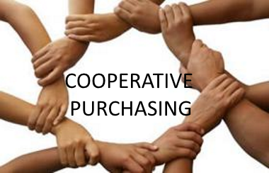
Collaboration
Curriculum development
Online resources:
wiki (e.g. http://wiki.team2537.com/)
slack
Low cost control systems
Bulk Purchasing: materials, insurance, transportation, hotel, tools/software
Scrimmages
Notes:
Example:

Slide 11
Alumni networking
Notes:
Mentors can help alumni find internships and new grads find *good* jobs

Slide 12
Open Discussion
What would be most interesting/useful
Where can you lead or help
Preferred collaboration tools
Other ideas?

Slide 13
Next Steps
Email contact info and interest to: david@dalbert.net
Slack channel for discussion
Follow up meeting(s)?

