Slide 1
Machine Vision
in FIRST Robotics
Benji Albert - Team 2537

Slide 2
Steamworks Auto
Gear Placement
Center Peg
Side Pegs
Fuel Dump
Fuel Shooting

Slide 3
Why use vision?

Slide 5
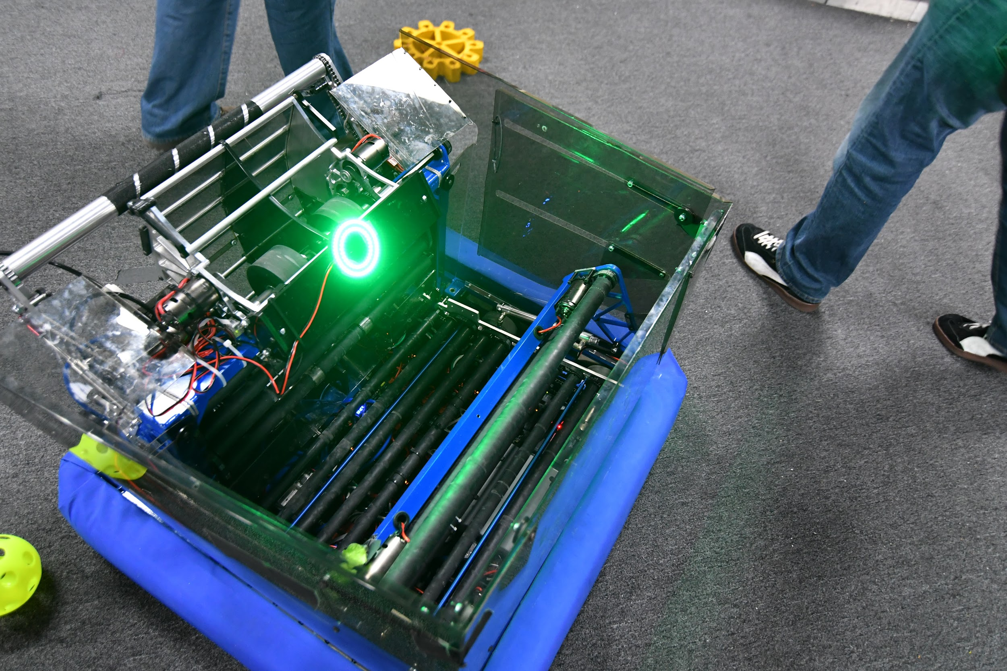
What are those green light rings you always see on FRC robots?

Slide 6
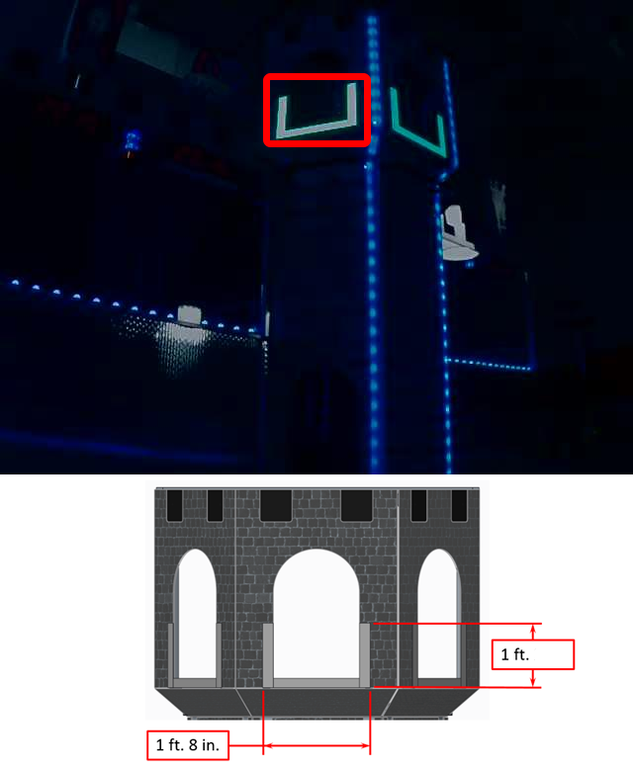
Retroreflective Tape
Andymark am-2934.htm
Field pieces almost always have retroreflective tape to aid with targeting.

Slide 7
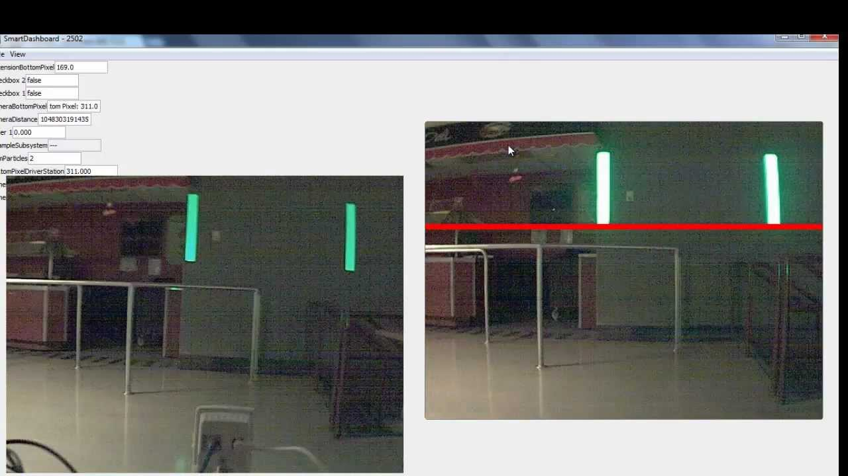

Slide 8
Vision Hardware
Total cost under $100
Raspberry PI 3 ($35)
Pi Camera v2 and cable ($30)
micro-SD Card ($7)
Enclosure ($12)
Voltage regulator (12->5v) or MP1584EN module ($3)
Light Ring
Monochrome (e.g. am-3597) ($6)
RGB/NeoPixel/WS2812 (e.g. amazon B0105VMWRM) ($8)
Spike or relay or transistor switch for light ring ($1)

Slide 9
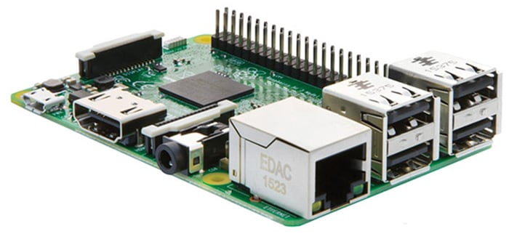
Raspberry Pi 3 Model B
Raspberry Pi 3
Quad core
1.2GHz
1GB DDR2
4x roboRIO!
$35

Slide 10
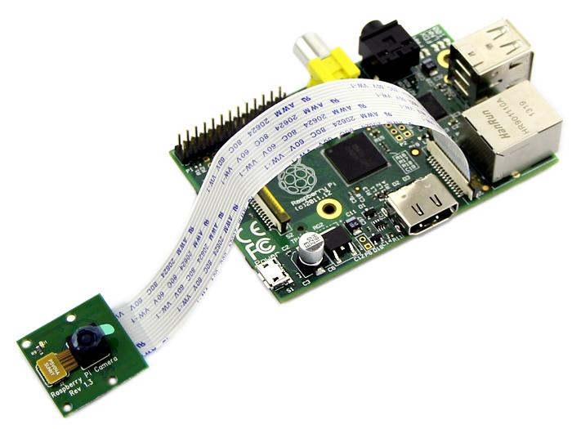
Video Camera
Raspberry Pi Camera v2:
8MP
1080p/30fps video
Up to 90fps with lower resolutions
Uses Pi GPU
$25-30

Slide 11
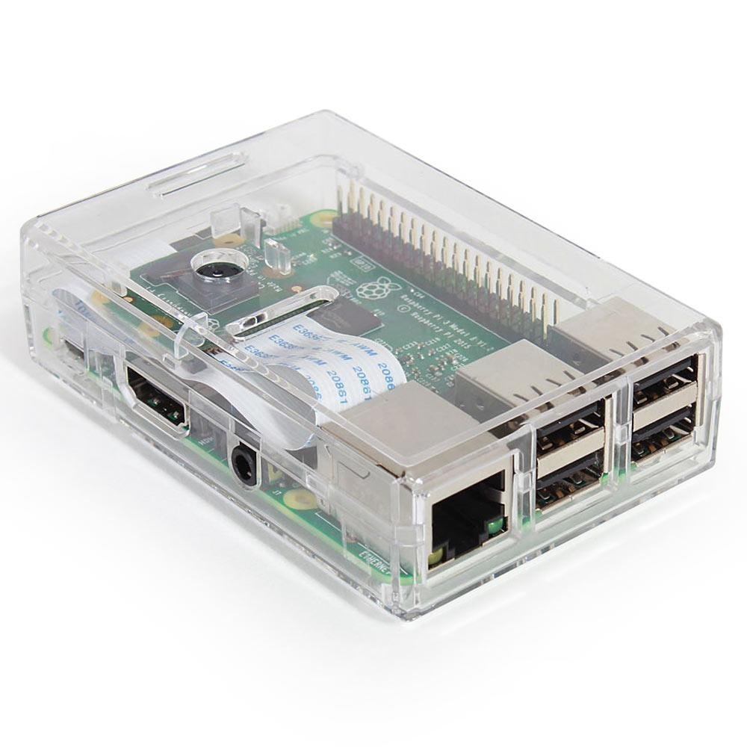
Enclosure
COTS enclosure
Polycarbonate
Secure mounting
Amazon B01KGTD3I0
$12

Slide 12
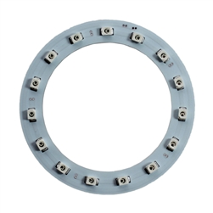
Light Ring
Mount to front of enclosure
AM-3597 Green ring $6
12v at up to 210mA
RGB WS2812 (Amazon B01KGTD3I0) $8-10
5v at up to 300mA

Slide 13
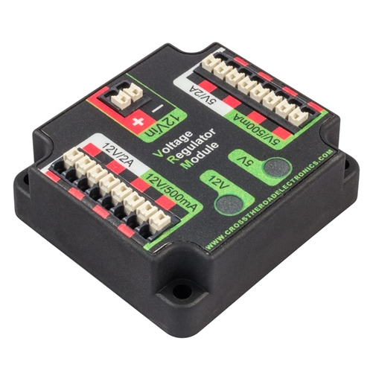
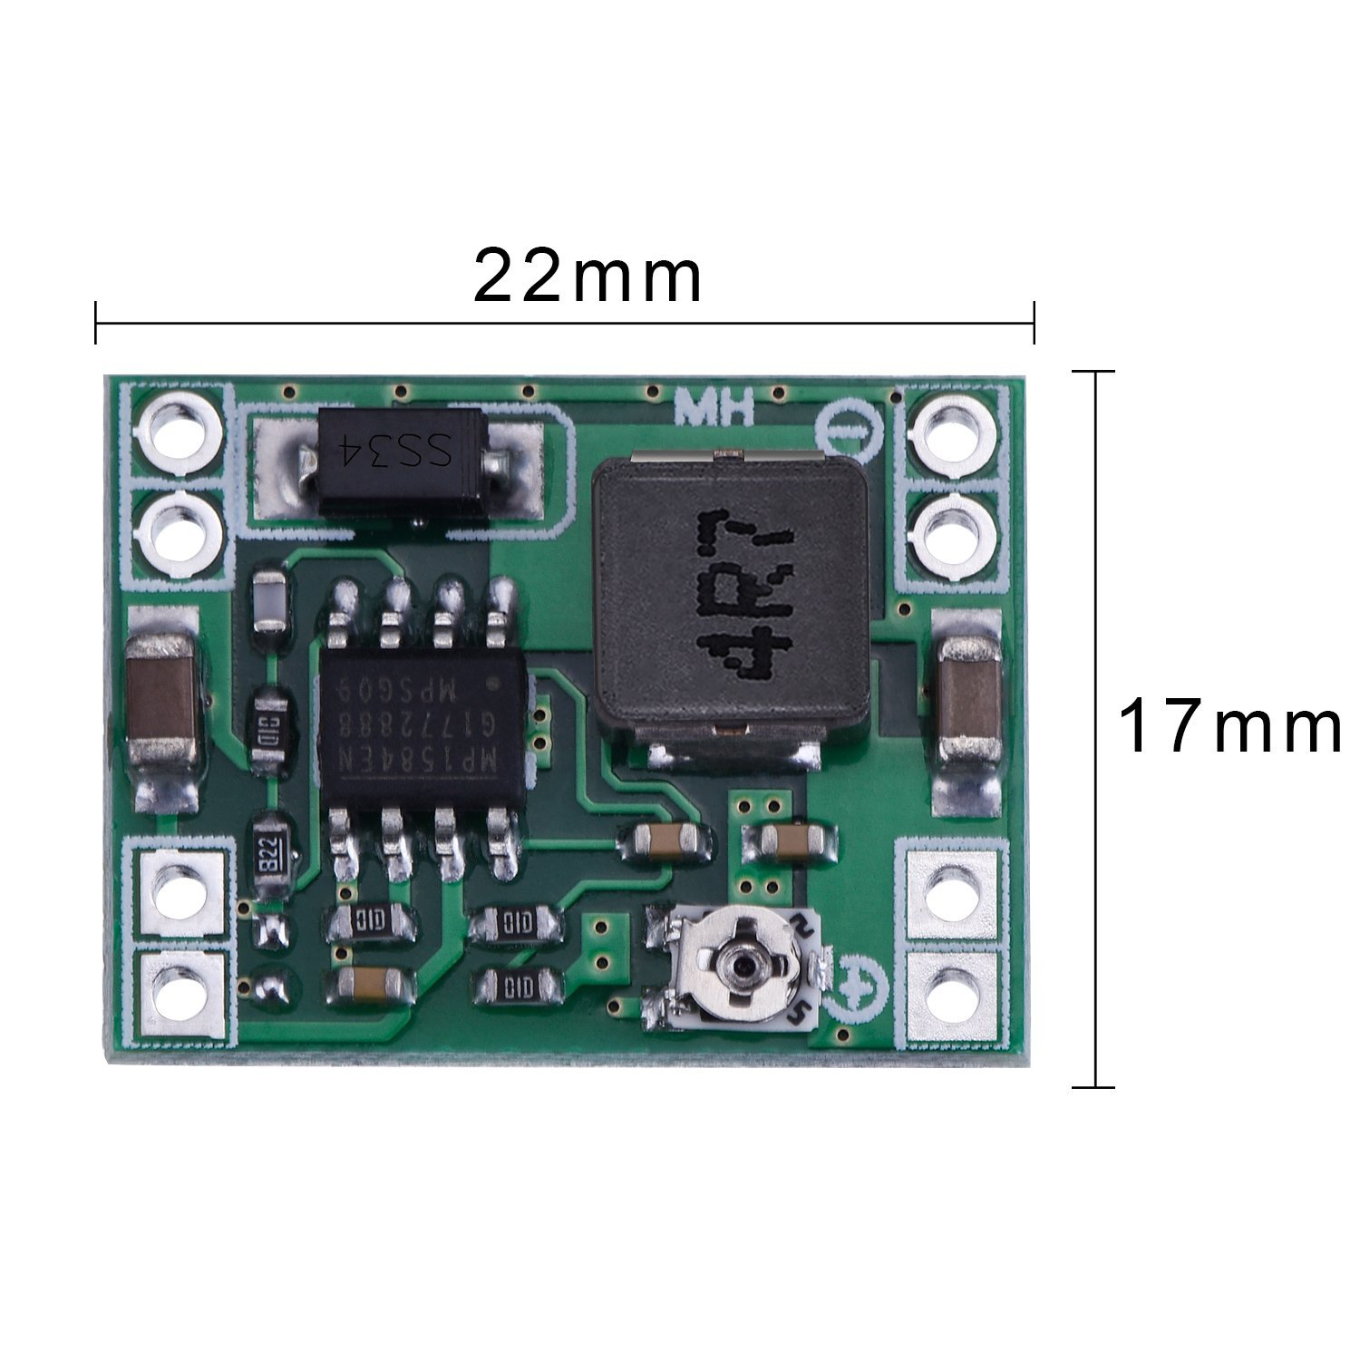
Power Supply
RPi3 runs on 5V and can consume > 1A
Light rings: 12v or 5v at 0.2 or 0.3A
AM-2857 VRM ($46)
MP1584EN (6 for $9.59) fits inside enclosure

Slide 14
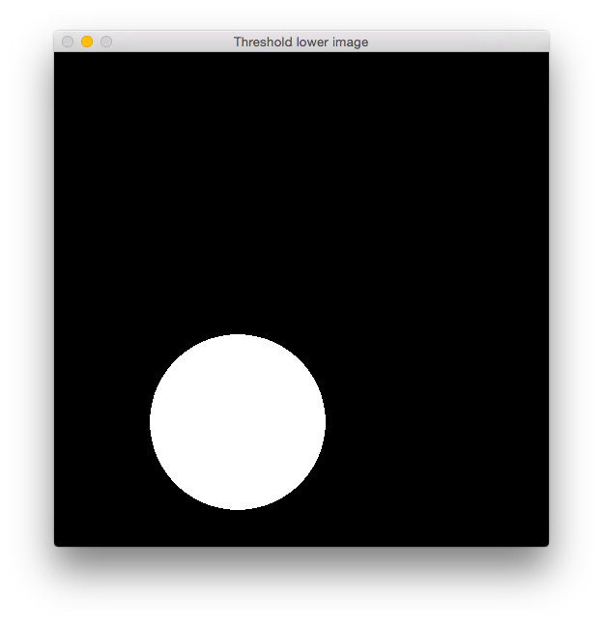
Vision Software
Raspbian Jesse (or newer)
VNC - running headless
OpenCV 3.20
Java Bindings
C++ Bindings

Slide 15
OpenCV Tricks and Tips
Mats and Scalars
Frame acquisition
Color spaces: RGB vs. BGR vs. HSV
Transforms: (cvtColor())
Blur/Smoothing (medianBlur())
Thresholding (inRange())

Slide 16
Communications and Control
The vision system must:
Turn on the light ring for autonomous period
Turn off the light ring for teleop
Communicate targeting information to roboRio such as direction to turn, distance to target, etc.
PWM
Asynch/Serial
Ethernet

